Slide 1
Expeditionary warfare school
Blended Seminar program
Graduation
13 December 2019
Camp Pendleton

Slide 2
Program
Invocation
National Anthem
Introductory Remarks
Introduction of Guest Speaker
Guest Speaker
Colonel Robert O. Bailey, USMC
Commanding Officer, MCTSSA
Presentation of Diplomas
Marines Hymn

Slide 3
Welcome, and thank you for attending the Graduation Ceremony for the Camp Pendleton Region Expeditionary Warfare School Blended Seminar Program course 003/004 for Academic Year 2020.
While approximately 20 – 30% of Marine Corps active duty officers attend a one-year resident intermediate or career-level school, the vast majority complete their professional studies through distance education programs offered by the College of Distance Education and Training.
Several years ago the Commandant directed an expansion of opportunities for officers to receive a “resident-like school experience.” This initiative was to become the Blended Seminar Program (BSP). Today, Blended Seminar Programs are offered at regional campuses at Camp Lejeune, Camp Pendleton, Hawaii, and Okinawa.
BSP provides a resident-like experience through two periods of resident instruction with the balance of the course conducted in an online format. The course is supported by a full time faculty of both active duty and retired Marines. This highly qualified full time staff carries each class through the entire program, much like the resident school. In addition to leading the seminars, faculty serve as role models and mentors. These faculty members deserve a special “thank you.” Without their hard work and dedication it would not have been possible to accomplish the goals of the programs.
Over the past six months, the program has covered topics such as Warfighting, Command and Control, Organization of the MAGTF, Operations Ashore, MAGTF Amphibious and Expeditionary Operations, and the Marine Corps Planning Process. Additionally, learners gained many benefits normally afforded only in a full-time resident program. These included guest speakers and guided discussions with leadership from all elements of the MAGTF to include General Officers. It also included multiple curriculum enhancing site visits.
In addition to providing exceptional resident-like education, the BSP develops officers who are proficient planners, strong MAGTF leaders and competitive for promotion and command. I am confident that each officer graduating today leaves the program a better MAGTF Officer and leader than when they entered.
The entire team at the Camp Pendleton Region College of Distance Education and Training wishes to extend “Congratulations” to today’s graduates. It has been our pleasure to serve you.
Semper Fidelis,
Jeffrey R. Willis, Regional Director

Slide 4
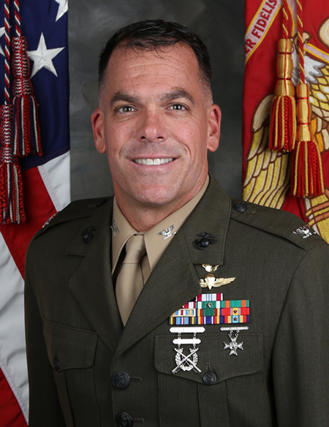
Colonel Robert O. Bailey, USMC
Commanding Officer
Marine Corps Tactical Systems Support Activity
Colonel Robert O. Bailey was born in Fairfax, VA, in 1973 and grew up in the National Capital Region. He attended the United States Naval Academy where he earned a Bachelor of Science in Political Science and a commission in the United States Marine Corps in 1995.
After attending the Basic School, Colonel Bailey attended the United States Army Field Artillery Officer Basic Course. Colonel Bailey's operational tours included duty with 10th Marine Regiment as a Forward observer, Guns Platoon Commander and Battery Executive Officer; and with the 2nd Reconnaissance Battalion as a Force Reconnaissance Platoon Commander, MEU Reconnaissance Detachment Officer-in-Charge and Maritime Special Purpose Force Commander, and Reconnaissance Company Commander. Colonel Bailey deployed with the 24th and 26th Marine Expeditionary Units (Special Operations Capable).

Slide 5
Colonel Bailey attended the Naval Postgraduate School where he earned a Master of Science in Management degree with a concentration in Defense Acquisition Management. His acquisition assignments include Test Management Officer for the Program Manager, Advanced Amphibious Assault; System Acquisition Manager for the Program Executive Officer for Special Programs and SOF Warrior Systems at the HQ USSOCOM; Branch Head and Assistant Operations Officer for the Marine Corps Tactical Systems Support Activity; Director for the Marine Corps Amphibious Vehicle Test Branch; and Product Manager for Infantry Combat Equipment.
Colonel Bailey is a distinguished graduate of the Eisenhower School where he earned a Master of Science in National Security and Resource Strategy. He is a Project Management Professional (PMP) and holds several DAWIA primary and subsidiary career field certifications, including Level III in Program Management; Level II in Systems Planning, Research, Development and Engineering; Level II in Test and Evaluation; and Level I in Production, Quality and Manufacturing.
Colonel Bailey is married to the former Ms. Carmen Fifer from Annapolis, MD, and they have two children.

Slide 6
Expeditionary warfare school
Blended seminar program graduates
Captain Royce D. Allen, USMC
Captain Zachary C. Ball, USMC
CWO3 Edward L. Beebe, USMC
GySgt Daniel P. Best, USMC
Captain Dion T. Byrd, USMC
Captain Peter C. Carl, USMC
Captain Amanda J. Carnes, USMC
Captain Joshua D. Chang, USMC
Captain Ian T. Constable, USMC
Captain Johnathan C. Craig, USMC
Captain Daniel J. Crain, USMC
Captain Jorgelius B. Diaz, USMC
Captain Brant W. Douville, USMC
Captain Nicholas V. Engle, USMC
Captain Andrew S. Galbraith, USMC
Captain Jeffrey Gibson, USMC
Captain Joshua C. Gornto, USMC
CWO3 Ralph E. Grimes, USMCR
Captain Joshua P. Hays, USMC
Captain Eric E. Jacobs, USMC
Captain Nathan D. Jones, USMC
CWO3 Andria Keeler, USMC
Captain Lukasz J. Kurowski, USMC
Captain Benjamin D. Lemisch, USMC
Captain Christopher J. Love, USMC
Captain Orry S. McDonald, USMC
Captain Colin A. Mckenna, USMC
Captain Richard M. Muller, USMC
CWO3 Jeremy A. Nansen, USMC
Captain Kristin N. Onofrio, USMC
Captain Liston H. Pennington, USMC
CWO3 Bennie A. Pettit, USMC
Captain Michael Pinar, USMC
Captain Michael A. Pittman, USMC
CWO3 Shawn T. Ryan, USMC
Captain Patrick H. Scannell, USMC
Captain Kyle D. Shaw, USMC
Captain Peter H. Shelton, USMC
Captain Patrick M. Snowman, USMC
Captain Timothy E. Stevenson, USMC
Captain Erin R. Torres, USMC
CWO3 Rosalind J. Twigg , USMC
Captain Thomas J. Ward, USMC

Slide 7
EWS BSP Faculty
Mr. Stefan Bien, Instructor
Mr. Willy Buhl, Instructor
Mr. Tye Wallace, Instructor
Mr. Jim Woulfe, Regional Chief Instructor EWS
Campus Staff
Mr. Jeff Willis, Regional Director
Major Nathan Hatfield, USMC, EWS BSP Faculty
Mrs. Monica Castillo, Administrative Assistant ECDEP
Mr. Mark Desens, CSC BSP Faculty
Mr. Hank Donigan, CSC BSP Faculty
Mr. Jack Hall, Regional Chief Instructor CSC DEP
Mr. Rob Hightower, Regional Chief Instructor ECDEP
Mrs. Kerrie Parsons, Administrative Assistant OPME
Mr. Harrison Tanksley, Regional Chief Instructor ECDEP

